Slide 1
Citi Bike Data Analysis
By [Lois Felix Bishio]

Slide 2
Project Goal:
To better understand the behavior of Citi Bike’s customer base (both one-time users and subscribers) and how they use Citi Bikes
This will help us to:
Identify where more bikes should be installed
Create targeted marketing campaigns that will appeal to different customer segments

Slide 3
Key questions:
What are the most popular pick-up locations across the city for Citi Bike rental?
How does the average trip duration vary across different age groups?
Which age group rents the most bikes?
How does bike rental vary across the two user groups (one-time users vs long-term subscribers) on different days of the week?
Does the factor of user age impact the average bike trip duration?

Slide 4
Findings & Insights

Slide 5
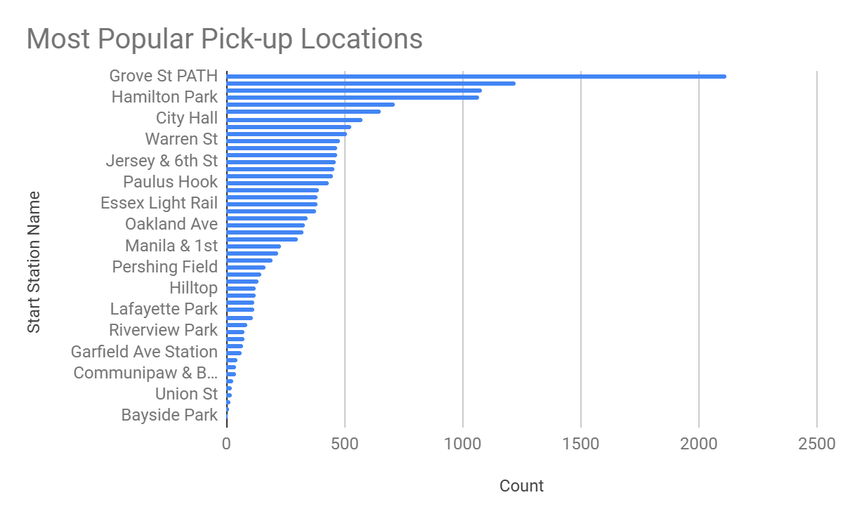
What are the most popular Citi Bike pick-up locations?
Add visualization here (Top 20 pick-up locations bar chart)

Slide 6
2. How does the average trip duration vary across different age groups?
Add visualizations here (column chart and line graph)
Add brief summary of what the visualizations tell us (remember: pick out the pearls!

Slide 7
3. Which age group rents the most bikes?
Add visualization here (bar chart)
Add brief summary of what the visualization tells us (remember: pick out the pearls!

Slide 8
4. How does bike rental vary across the two user groups (one-time users vs long-term subscribers) on different days of the week?
Add visualization here (stacked stepped area chart)
Add brief summary of what the visualization tells us (remember: pick out the pearls!

Slide 9
5. Do factors like weather and age impact the average bike trip duration?
Add visualizations here (2 scatter plots)
Add brief summary of what the visualizations tell us (remember: pick out the pearls!

Slide 10
Summary

Slide 11
Summary of findings:
Top 5 pick-up locations for bikes:
Grove St Path, Exchange Place, Sip Ave, Hamilton Park, & Morris Canal
Customer base:
Based on your findings, how would you describe Citi Bike’s customer base? Think in terms of characteristics like age and user type
Citi Bike customer behavior:
Who takes the longest and shortest trips on average?

Slide 12
Actions & Recommendations

Slide 13
Recommended actions:
Product recommendations:
Install more bikes at ...
Marketing recommendations:
The Citi Bike customer base is mostly [user type]...aged between..., who are most active .[weekday or weekends?]... This tells us that they are probably people who live in New York and use Citi Bikes to commute. Marketing and advertising campaigns should therefore target this particular demographic.

Slide 14
Thank you!

